Slide 1
Create Report From Database
Business Analyst Nanodegree

Slide 2
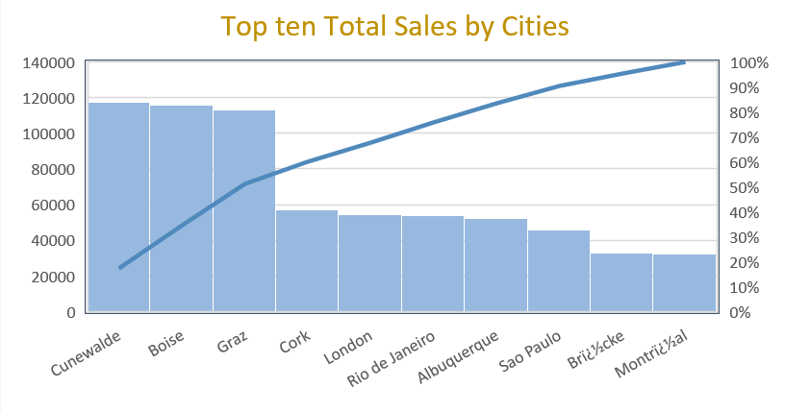
Top Ten Cities for sales
The chart represent top 10 cities that has the highest sales. The highest city is cunewalde with $117483.39 sales value.
SQL Query: SELECT Customers.City, SUM(unitPrice*Quantity) as Total_Sales FROM orderdetails Join orders On orderdetails.orderid=orders.orderid Join Customers On Customers.CustomerID=orders.CustomerID GROUP BY City ORDER BY Total_Sales DESC limit 10;
Total Sales
Cities

Slide 3
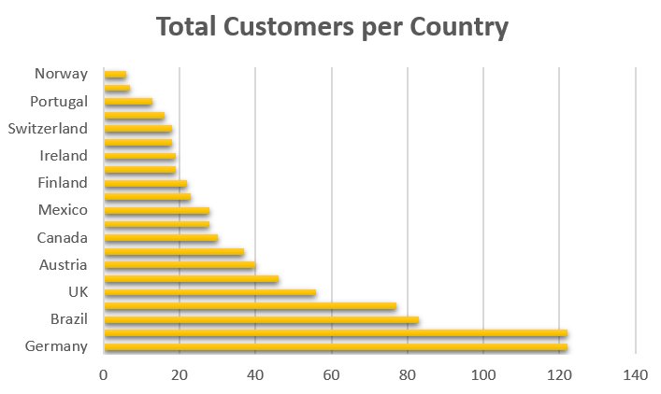
Total customers per country
The total customers generated by each country is illustrated with Germany and Brazil being the countries with most customers of roughly 120 customers.
SQL Query: SELECT Orders.ShipCountry as Country, count(customers.CustomerID) as TotalCustomers From Customers Join Orders On Customers.CustomerID=Orders.CustomerID GROUP BY Country ORDER BY TotalCustomers desc;
Countries
Total Products

Slide 4
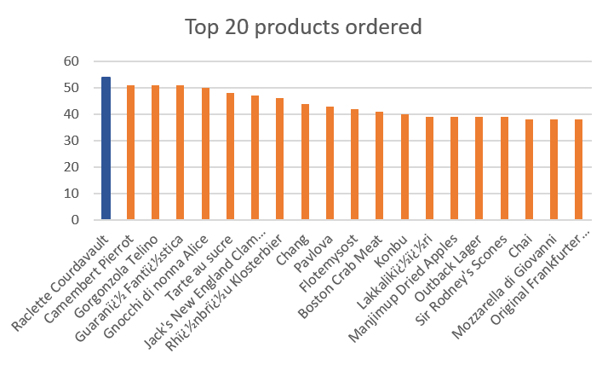
top 20 best selling products
The chart shows the top 20 best selling products. Raclette Product is the best seller, Records the highest number of orders exceeded the 50 orders
SQL Query: SELECT Products.ProductID, Products.productName, count(OrderDetails.Quantity) as Total_Orders From Products join OrderDetails On Products.ProductID= OrderDetails.ProductID Group by ProductName Order by Total_Orders desc limit 20;
Total Orders
Products

Slide 5
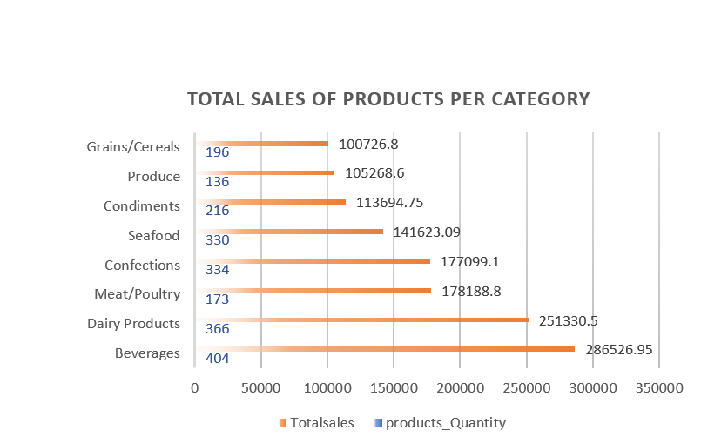
Total Sales Of Products Per Category
The graph above shows total sales and the sales percentage by product category. Beverages registered the highest sales while Grains/Cereals has the lowest sales.
SQL Query: SELECT CategoryName, count(Products.ProductID)as products_Quantity, SUM(orderdetails.unitprice*orderdetails.quantity) as Totalsales FROM categories, products, orders, orderdetails, (SELECT SUM(orderdetails.unitprice*orderdetails.quantity) as TotalSales FROM orderdetails Join Products On orderdetails.ProductID=Products.ProductID) Revenue WHERE categories.categoryid=products.categoryid and products.productid=orderdetails.productid and orderdetails.orderid=orders.orderid GROUP BY Categoryname ORDER BY Totalsales desc;
Categories

